Slide 1
Lesson 06 Exponential Distribution Concepts
E214 – Statistical Methods for Engineering

Slide 2
E214 – Statistical Methods for Engineering
Inferential Statistics
Hypothesis Testing
Parameter Estimation
Organise & summarise data collected
Probability and Distributions
Venn Diagram
Discrete Random Variables and Probability Distributions
Probability Distributions
Descriptive Statistics
Continuous Random Variables and Probability Distributions
Binomial Distribution
Poisson Distribution
Normal Distribution
Exponential Distribution
Tree Diagram
A more detailed topic tree on Hypothesis Testing will be given from P08 onwards
L06

Slide 3
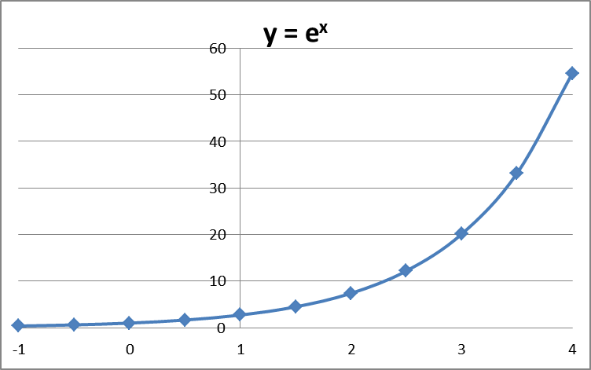
Recall: Exponential Function
An exponential function has the form:
y = a^{x} (where a is a positive constant called the base.)
The most commonly used exponential function is:
y =e^{x} (where the base e is the constant 2.7182...)
(Excel: EXP(x))
Use the caret (^) to perform exponential operations in Excel

Slide 4
Recall: Logarithms
If b^{x} = N, where N is positive number and b is positive number (not equal to 1), then exponent x is the logarithm of N to the base b and is written as:
x = log_{b}N
Common Logarithms: The system of logarithms whose base is 10 is called the common logarithm system. For example, log(25) = log₁₀25
Natural Logarithms: The system of logarithms whose base is the constant e is called the natural logarithm system. i.e. ln(25) = log_{e}25
[EXCEL function as: LN(25)]

Slide 5
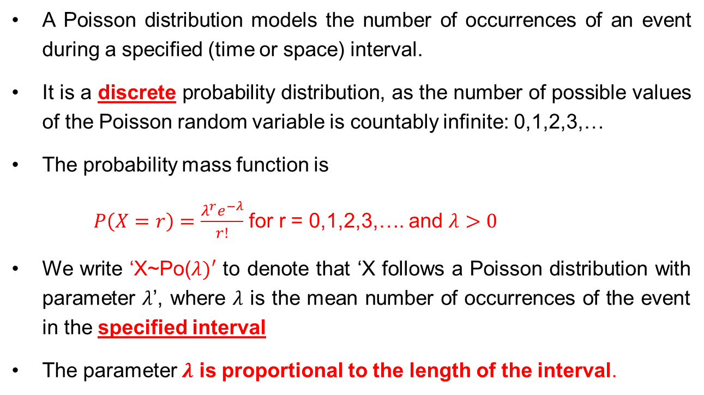
Recall: Poisson Distribution
A Poisson distribution models the number of occurrences of an event during a specified (time or space) interval.
It is a discrete probability distribution, as the number of possible values of the Poisson random variable is countably infinite: 0,1,2,3,…
The probability mass function is
$P\left(X=r\right)=\frac{λ^{r}e^{−λ}}{r!}$ for r = 0,1,2,3,…. and $λ>0$
We write ‘X~Po($λ)′$ to denote that ‘X follows a Poisson distribution with parameter $λ$’, where $λ$ is the mean number of occurrences of the event in the specified interval
The parameter $λ$ is proportional to the length of the interval.
If another random variable represents the length of time or space interval between any two successive occurrences of the event, what probability distribution does it follow?

Slide 6
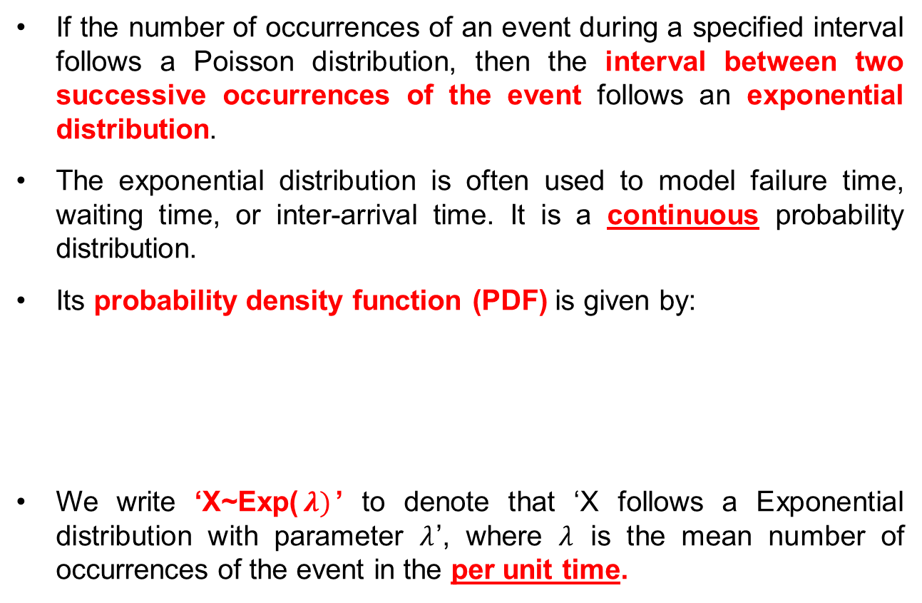
Introduction to the Exponential Distribution
If the number of occurrences of an event during a specified interval follows a Poisson distribution, then the interval between two successive occurrences of the event follows an exponential distribution.
The exponential distribution is often used to model failure time, waiting time, or inter-arrival time. It is a continuous probability distribution.
Its probability density function (PDF) is given by:
We write ‘X~Exp($λ)$’ to denote that ‘X follows a Exponential distribution with parameter $λ$’, where $λ$ is the mean number of occurrences of the event in the per unit time.

Slide 7
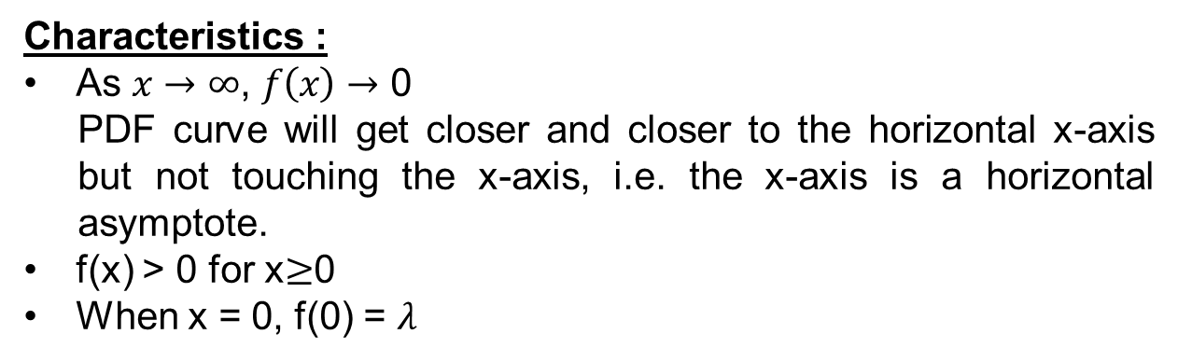

PDF Curve for Exponential Distribution
f(x)
$$λ$$
0
x
Characteristics :
As $x→∞$, $f\left(x\right)→$ 0
PDF curve will get closer and closer to the horizontal x-axis but not touching the x-axis, i.e. the x-axis is a horizontal asymptote.
f(x) > 0 for x$≥$0
When x = 0, f(0) = $λ$

Slide 8
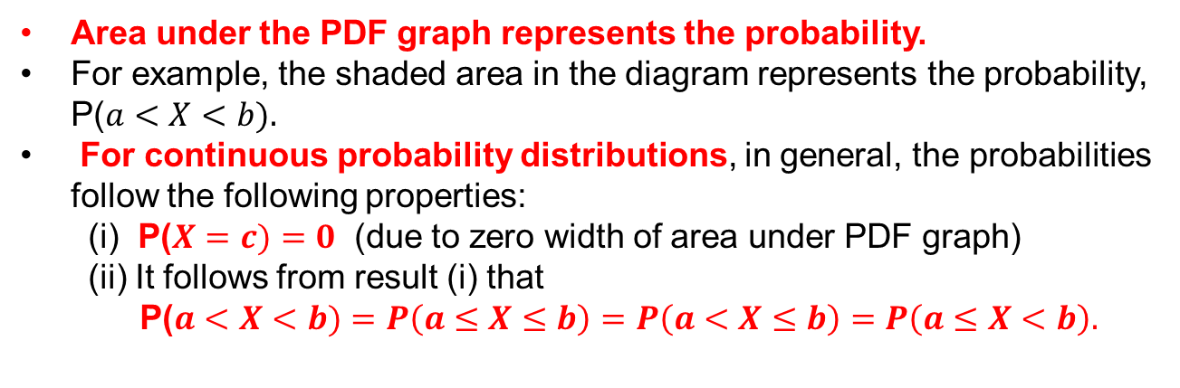


PDF Curve and Probability
f(x)
$$λ$$
P($a<X<b)$
0
a
x
b
c
Area under the PDF graph represents the probability.
For example, the shaded area in the diagram represents the probability, P($a<X<b).$
For continuous probability distributions, in general, the probabilities follow the following properties:
(i) P($X=c)=0$ (due to zero width of area under PDF graph)
(ii) It follows from result (i) that
P($a<X<b)=P\left(a≤X≤b\right)=P\left(a<X≤b\right)=P\left(a≤X<b\right).$

Slide 9


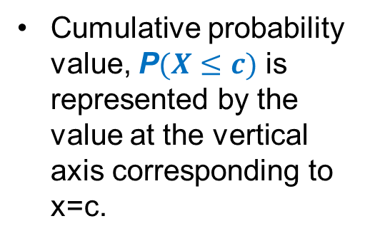

CDF for Exponential Distribution
The cumulative distribution function (CDF) for an exponential distribution is denoted by F(x), where F(x) = P(X$≤$x).
$F\left(x\right)=1−e^{−λx}$, for $x≥0.$
The cumulative distribution function (CDF) curve for exponential distribution is as shown below:
F(x)
$$1$$
Cumulative probability value, P$(X≤c)$ is represented by the value at the vertical axis corresponding to x=c.
P$(X≤c)$
0
x
c

Slide 10
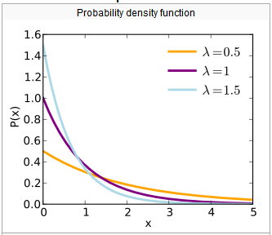
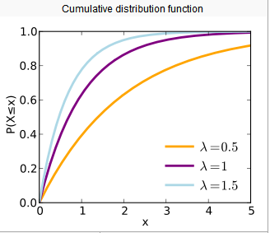
Exponential Distribution: PDF and CDF Curves

Slide 11
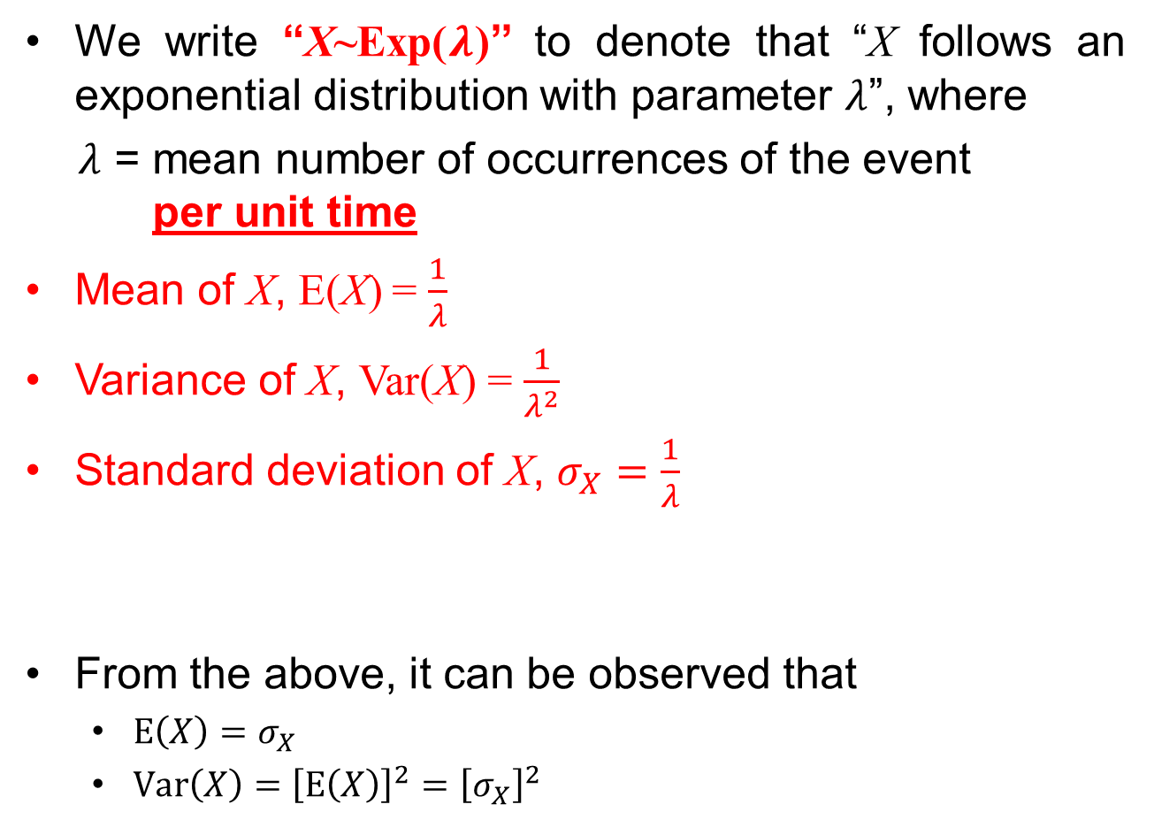
Mean, Variance and Standard Deviation of an Exponential Random Variable
We write “X~Exp($λ$)’’ to denote that “X follows an exponential distribution with parameter $λ$”, where
$λ$ = mean number of occurrences of the event per unit time
Mean of X, E(X) = $\frac{1}{λ}$
Variance of X, Var(X) = $\frac{1}{λ^{2}}$
Standard deviation of X, $σ_{X}=\frac{1}{λ}$
From the above, it can be observed that
$E\left(X\right)=σ_{X}$
$Var\left(X\right)={\left[E\left(X\right)\right]}^{2}={\left[σ_{X}\right]}^{2}$
The subscript “x” is used to mean “standard deviation of X”

Slide 12
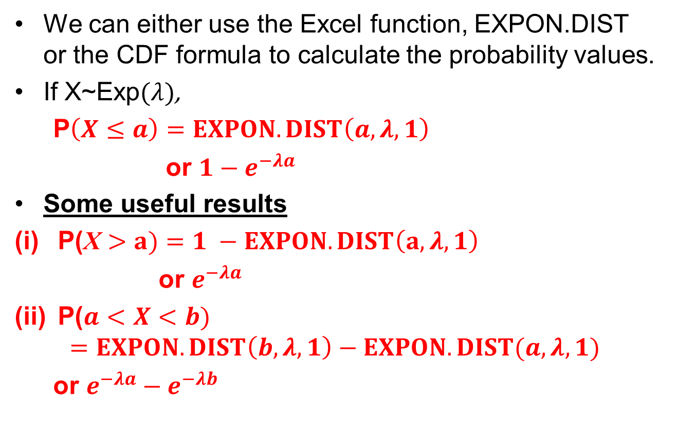
Calculating Exponential Probabilities
We can either use the Excel function, EXPON.DIST or the CDF formula to calculate the probability values.
If X~Exp$(λ)$,
P$\left(X≤a\right)=EXPON.DIST\left(a,λ,1\right)$
or $1−e^{−λa}$
Some useful results
P(X $>a)=1 −EXPON.DIST\left(a,λ,1\right)$
or $e^{−λa}$
P($a<X<b)$
$$=EXPON.DIST\left(b, λ,1\right)−EXPON.DIST(a,λ,1)$$
or $e^{−λa}−e^{−λb}$

Slide 13
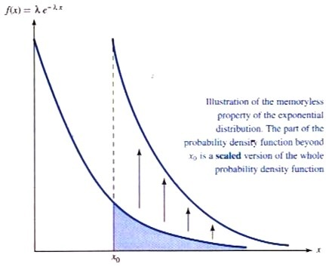
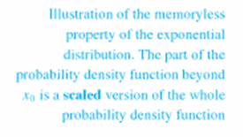
Exponential Distribution: Memorylessness Property
Memoryless Property
P(X > s + t | X > s) = P(X > t) s, t ≥ 0
or P(X < s + t | X > s) = P(X < t) s, t ≥ 0
Reliability: The amount of time a component has been in service has no effect on the amount of time until it fails
Inter-event times: The amount of time since the last event contains no information about the amount of time until the next event
Service times: The amount of remaining service time is independent of the amount of service time elapsed so far
Illustration of the memoryless property of the exponential distribution. The part of the probability density function beyond s is a scaled version of the whole probability density function
s

Slide 14
Exponential Distribution: Memorylessness Property
Memoryless Property
P(X > s + t | X > s) = P(X > t) s, t ≥ 0
or P(X < s + t | X > s) = P(X < t) s, t ≥ 0
Proof:
P(X > (s + t) | X > s)
= P(X > (s + t) ∩ X > s) / P(X > s)
= P(X > (s + t)) / P(X > s)
= e^{(-λ*(t + s))}/e^{(-λ*s)}
= e^{(-λ*t)}
= P(X > t)

Slide 15
Differences Between the Poisson and the Exponential Distributions
The Poisson distribution models the number of occurrences of an event during a specified time or space interval, while the exponential distribution models the length of time or space interval between any two successive event occurrences.
The Poisson distribution is a discrete probability distribution, while the exponential distribution is a continuous distribution.
Note: Although there is one parameter, λ, in both the Poisson and the exponential distributions, they have different meanings as follows:
In the Poisson distribution, λ is the mean number of occurrences within a given time interval
In the exponential distribution, λ is the mean number of occurrences per unit time.

Slide 16
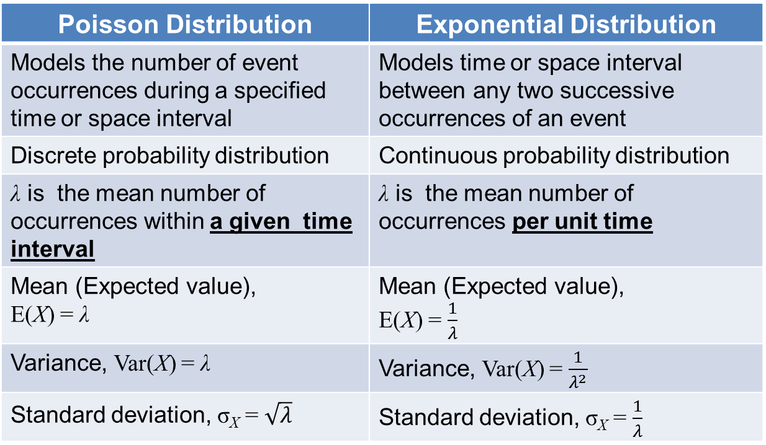
Differences Between the Poisson and the Exponential Distributions
Poisson Distribution | Exponential Distribution
Models the number of event occurrences during a specified time or space interval | Models time or space interval between any two successive occurrences of an event
Discrete probability distribution | Continuous probability distribution
λ is the mean number of occurrences within a given time interval | λ is the mean number of occurrences per unit time
Mean (Expected value), E(X) = λ | Mean (Expected value), E(X) = $\frac{1}{λ}$
Variance, Var(X) = λ | Variance, Var(X) = $\frac{1}{λ^{2}}$
Standard deviation, σ_{X} = $\sqrt{λ}$ | Standard deviation, σ_{X} = $\frac{1}{λ}$

Slide 17
Learning Objectives
Identify continuous random variables
Define an exponential random variable
Describe the characteristics and memoryless property of an exponential distribution
Apply the formulae to calculate the mean, variance and standard deviation of an exponential random variable
Apply the exponential distribution model to calculate probabilities (to model failure time, waiting time, or inter-arrival times, etc.)

Slide 18
E-Learning Video
You are strongly encouraged to watch the e-learning video prepared for L06 to enhance your understanding of the main learning objectives.
You can access the e-learning video from the following link:
https://drive.google.com/file/d/0B0VVo-P5cYtqTV9TY0ljazFsaVU/edit?usp=sharing

